Slide 1
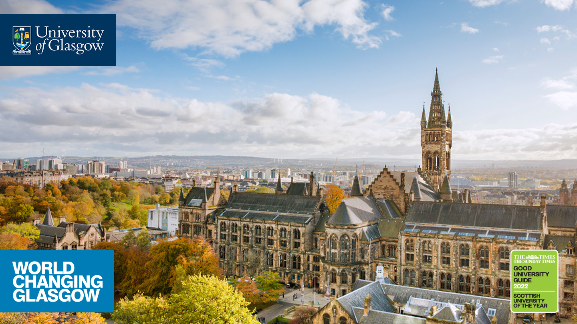
Social media, entangled conflict memories, and peacebuilding in post-violence societies
Paul Reilly
University of Glasgow

Slide 2
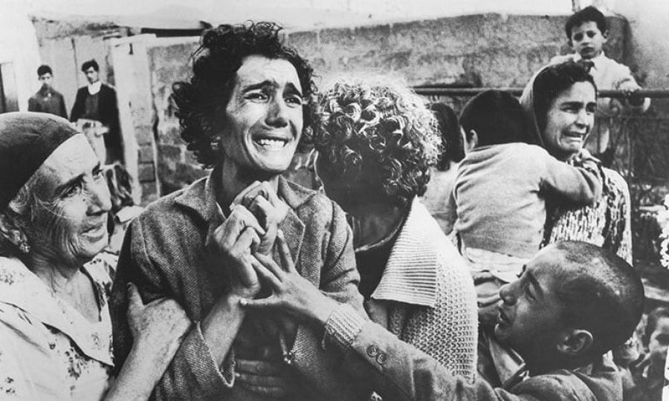
Iconic photographs play key role in how communities remember conflict
Photographs lose their emotional charge over time, with the exception of images of WW2 Nazi concentration camps (Sontag, 1977).
Images capable of both telling the ‘truth’ and ‘lying’, as demonstrated by staged early war photography (Ritchin, 2013).
Photographs help both individuals and communities produce memories - a “secondary revision” of the past rather than representing it “as it was” (Kuhn, 2000: 186).
Don McCullin image of Turkish Cypriot woman, Nevcihan Olusum, finding out her husband had been killed in 1964

Slide 3
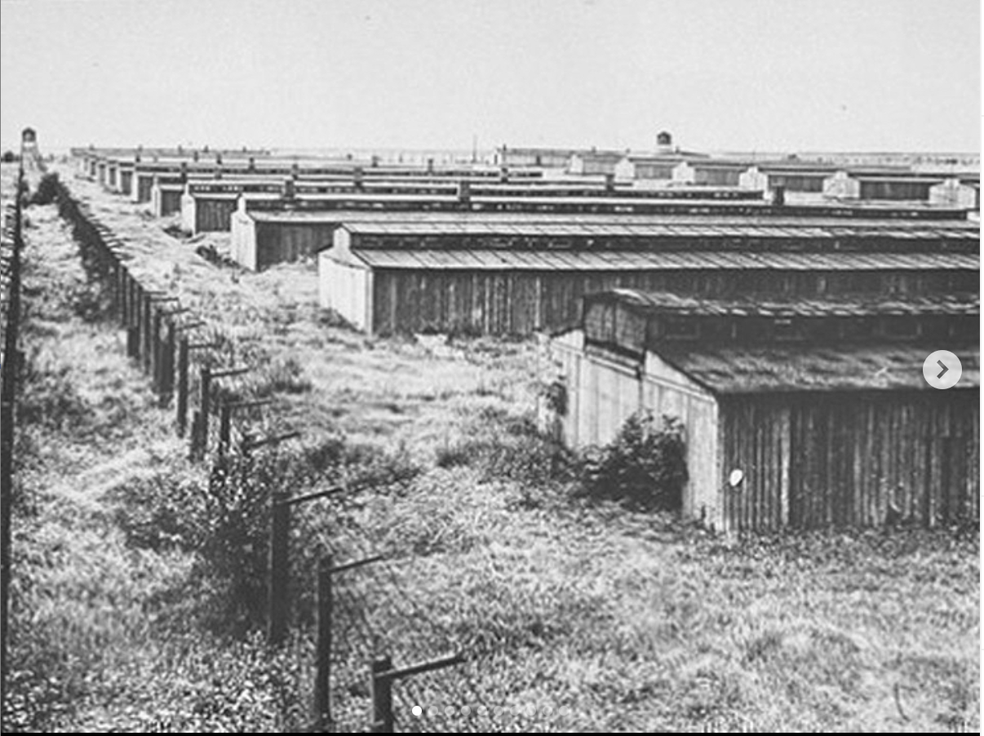
From collective memory to a fluid, ever-changing memory of the multitude?
Halbwachs (1992) defines collective memory broadly as the process whereby groups produce memories of events they have no direct experience of (typically based on mnemonic aids provided by media)
Olick (1999: 338) introduces concept of ‘collected memories’ to capture how social frameworks shape what individuals remember, but “ultimately it is only the individuals who do the remembering”.
Connective turn challenges CM (if it ever existed) with a scatted, searchable and digitally mediated ‘memory of the multitude’ (Hoskins, 2017; 2026)
Holocaust Memory

Slide 4
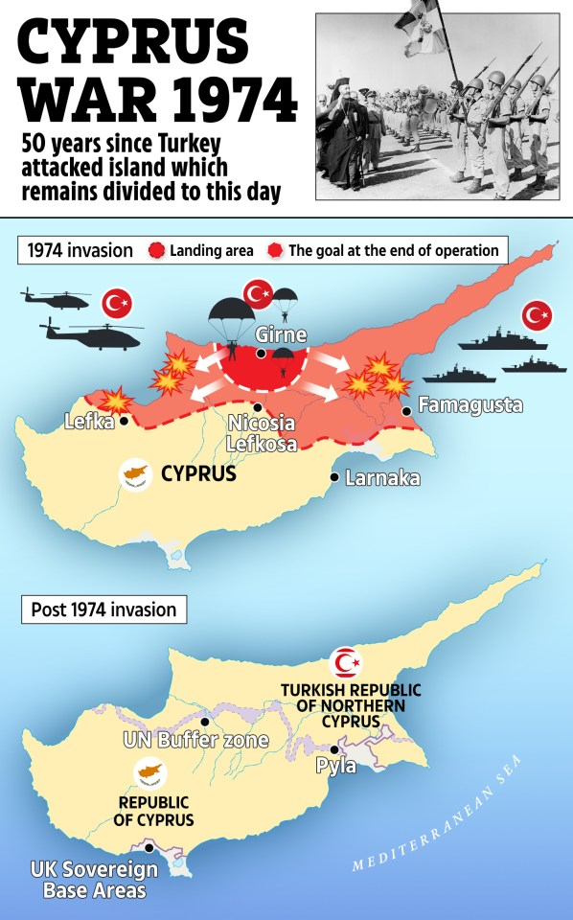
How conflicts are remembered influences the quality of peace
Communicative remembering as ongoing process whereby memories are constructed and shared (both in-person and via participatory media practices)
Memories are not innate- they are something memory agents (humans and machines) do and enact (Lohmeier & Pentzold, 2025)
Higher quality peace more likely if the memories are entangled and their politics are inclusive, pluralistic, and promote dignity for all victims (Mannergren et al, 2024).
The Sun commemorates 50 years since Turkish invasion of Cyprus

Slide 5
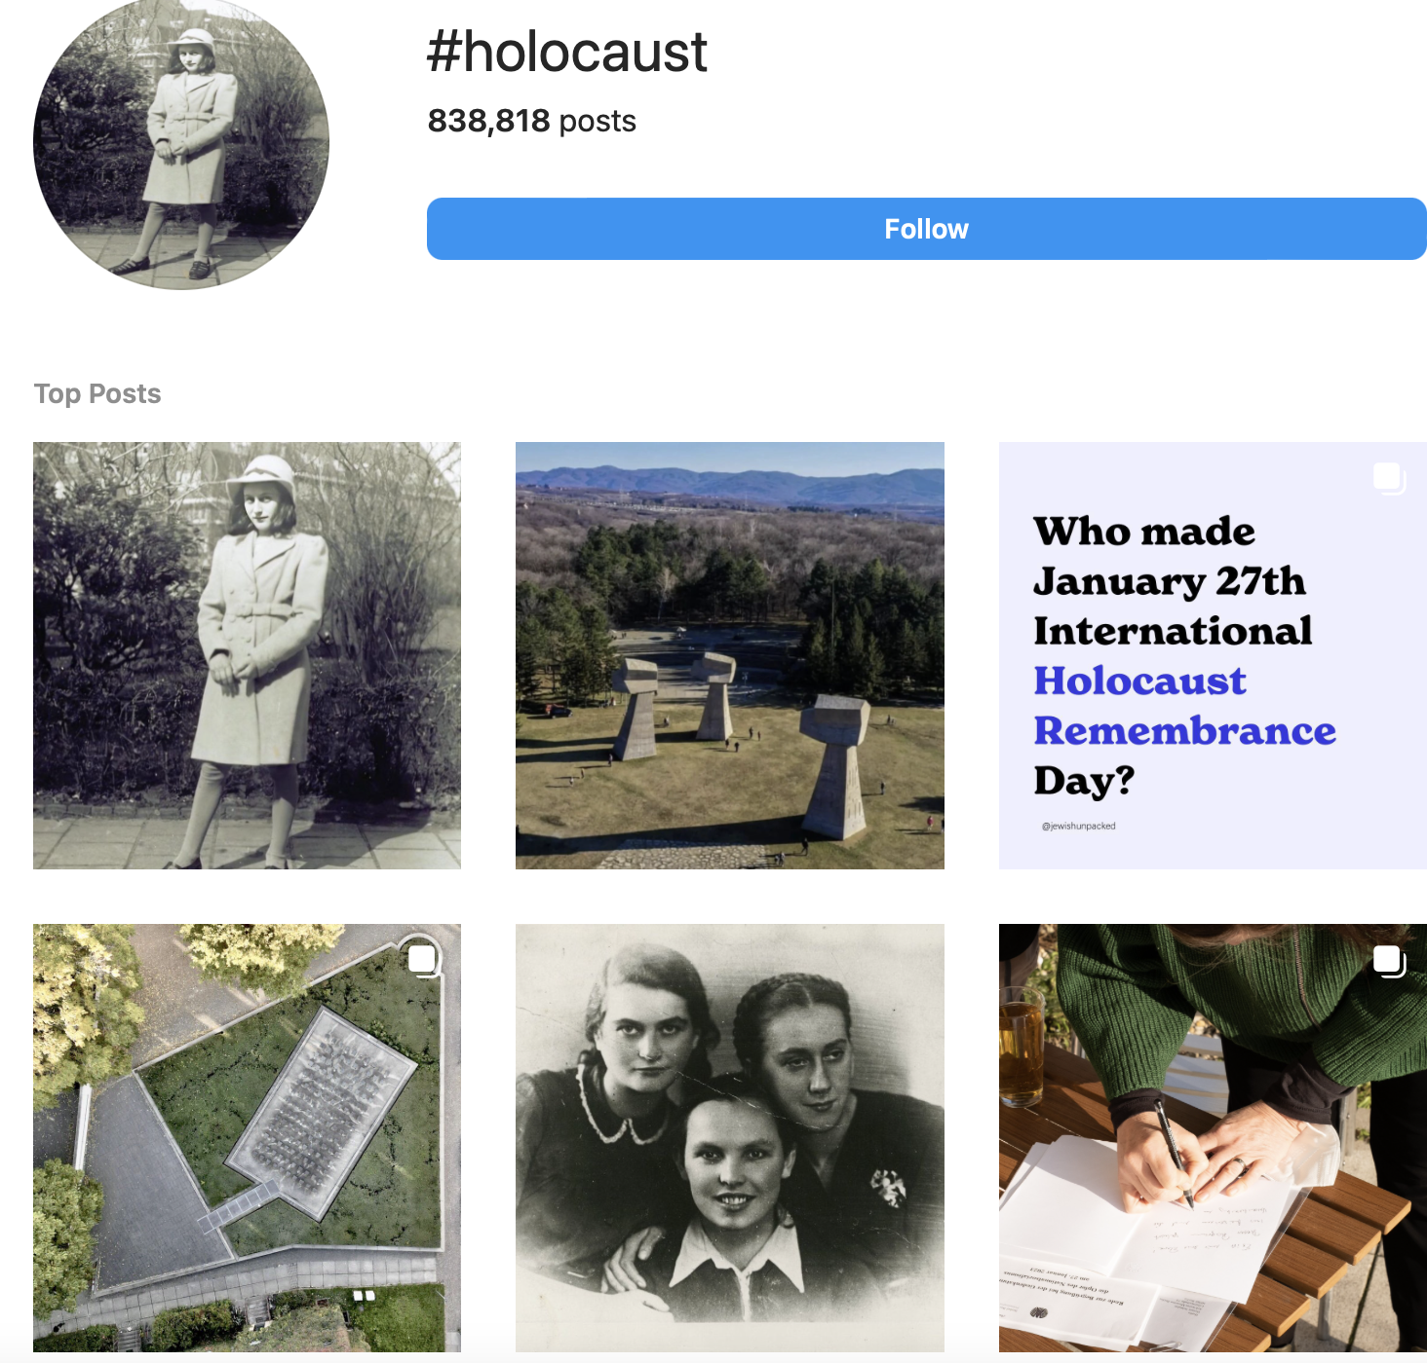
Insta also facilitates Holocaust remembrance among younger audiences
“The inconsistencies and varieties of representations uploaded to Instagram using #Auschwitz sustain and continuously generate discussions about sites of trauma” (Commane and Potton, 2019:178)
“Tension between the conflict memory discourses endorsed by institutions and media practices of young people who experience these events through their social media feeds […] this does not necessarily mean that the key message of ‘never again’ is being lost on audiences” (Reilly, Salojärvi & Russell, forthcoming, p.9)

Slide 6
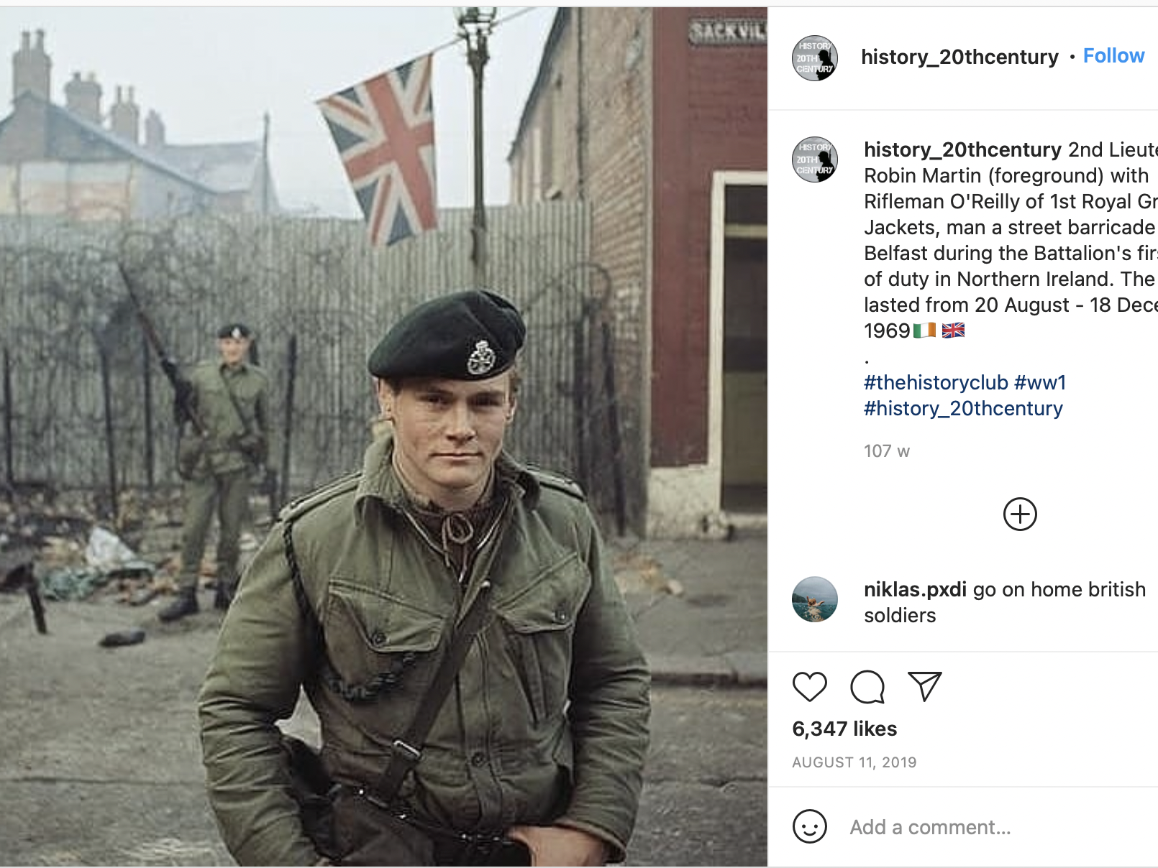
Instagram and partisan conflict memories in ‘post-conflict’ NI (Reilly, 2025)
New opportunities for iconic images of Troubles “to be spoken for as a new form of counter memory”
Many comments focus on aesthetics rather than the dignity of victims- with exception of those featuring British army that generate hostile commentary
Reinforcing zero-sum narratives on conflict, rather than promoting new interpretations that build support for peace in ‘post-conflict’ NI

Slide 7
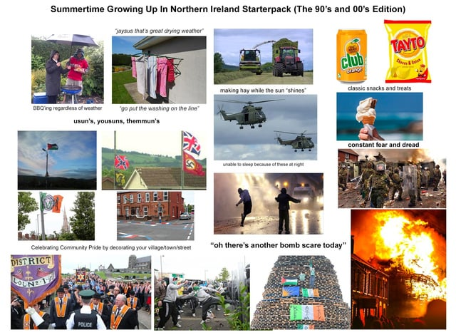
Lundqvist (forthcoming): Meme-orialization divides audiences
“Some conceive of the meme as offering a welcome injunction to laugh at the troubled past. As such, they see it as an indication that Northern Ireland as a society is finally moving on from ‘The Troubles’. Other interlocutors rather argued that the meme is narratively bringing back the past into the present, which risks re-traumatizing certain individuals and stirring sectarian tension in the present”
Summertime growing up in Northern Ireland Starterpack

Slide 8
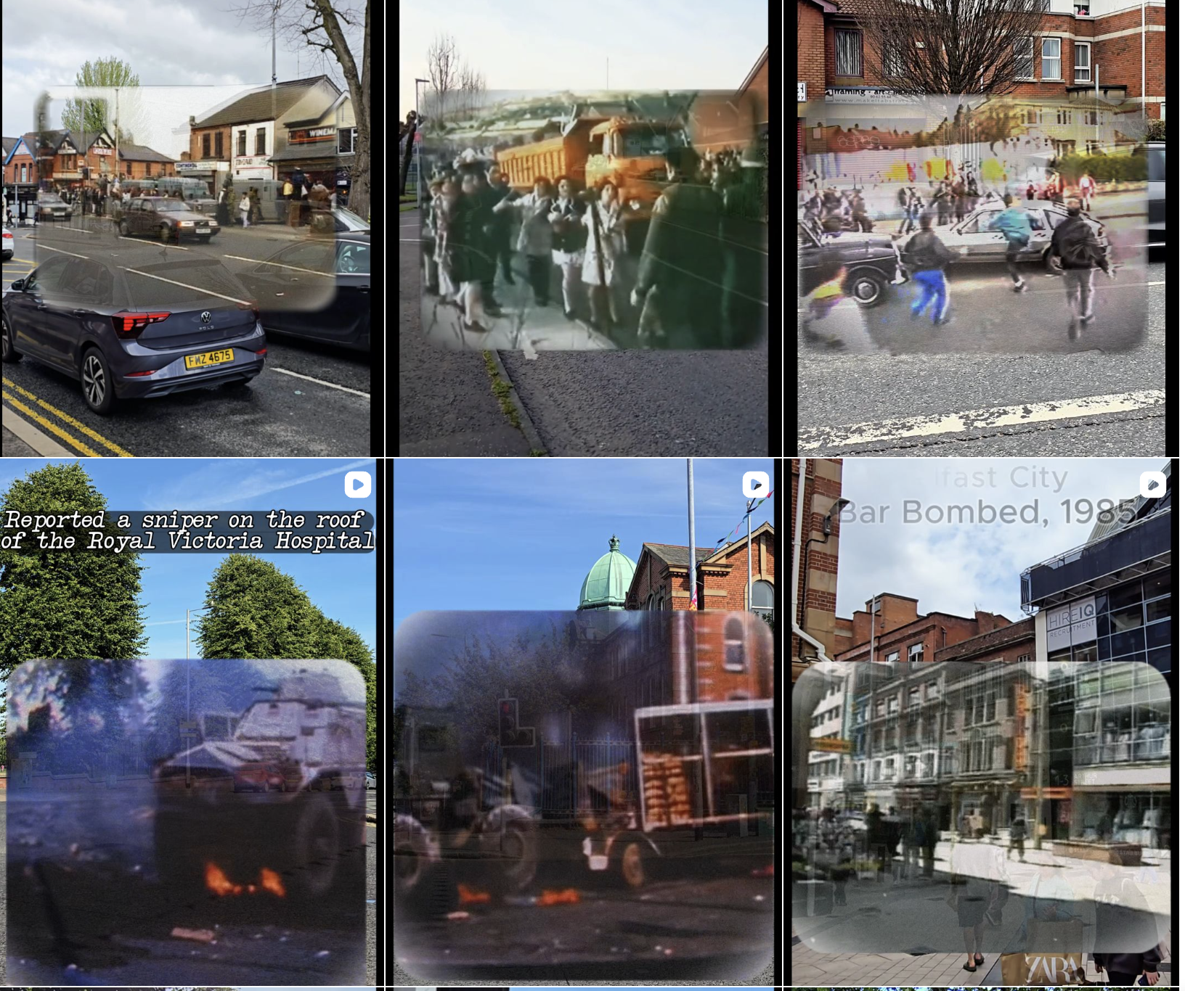
Slickshots NI splices footage of atrocities with present-day (with mixed responses)

Slide 9
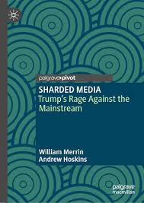
Personalised war feeds replace mass-produced reality of MSM
“We each exist in our own sharded, filtered, algorithmically and personally-fed realities. The dominance of the feed. 2022 BBC has now become sharded from the battlefield in Ukraine. The mainstream reporting on Gaza is even worse, failing to capture the horror and destruction. Instead, each of us has our own feed. Each of us, therefore, has our own war and even following or agreeing on what is happening becomes impossible’ (Merrin & Hoskins, 2024, p.32)

Slide 10
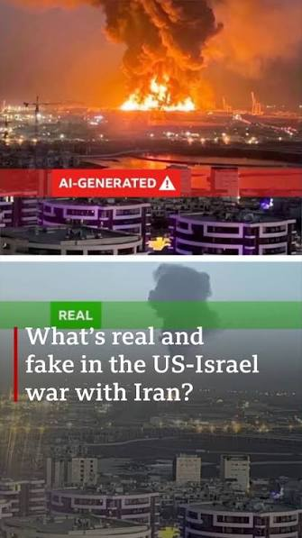
Agentic turn: game changer for conflict memory?
Memory rendered myopic as scope constrained by neoliberalism (Pilkington, 2024)
Gen AI images and hallucinations “fatal for memory’s trust, provenance and future” (Hoskins, 2026:1)
Memory materials (e.g. commentary, images, videos) created by GenAI even more problematic than the historical photographs shared on Instagram? Not even half-truths?
BBC coverage of US-Israel war with iran

Slide 11
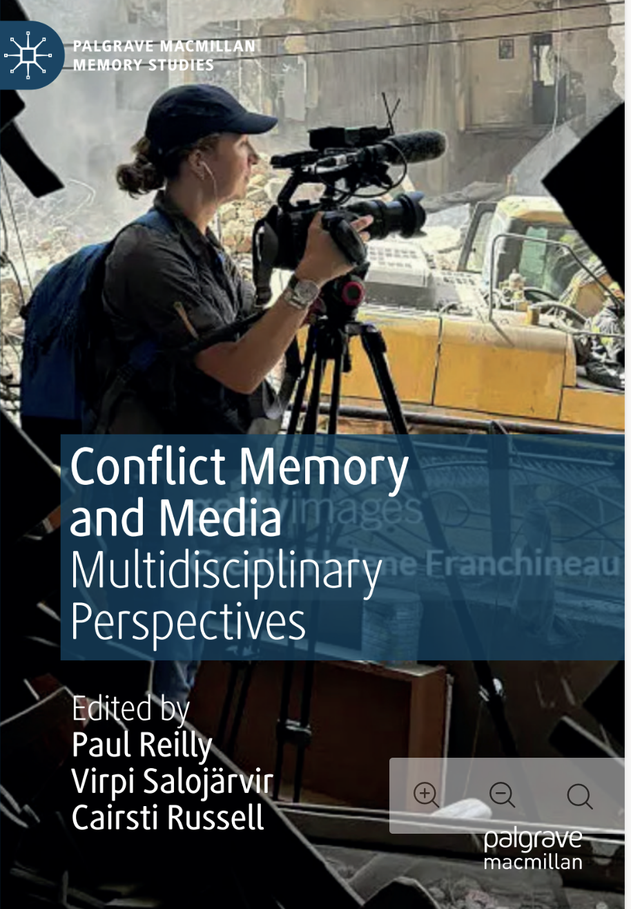
Concluding remarks
Online conflict memory materials do not promote higher quality peace- audiences remain divided along partisan lines with few reappraisals of the past
Contemporary informational infrastructures (e.g. GenAI) constrain what is collectively and individually remembered, promoting falsehoods e.g. hallucinations that make it harder to foster consensus over what happened during conflict
Platforms not the only conflict memory agents- politicians, media and civil society actors have greater responsibility to leverage past to build peace in the present (Reilly, Salojärvi & Russell, forthcoming)

Slide 12
References
Commane, G. & Potton, R. (2019) Instagram and Auschwitz: a critical assessment of the impact social media has on Holocaust representation, Holocaust Studies, 25(1-2): 158-181
Halbwachs, M. (1992). On collective memory (L. A. Coser, Ed. & Trans.). University of Chicago Press.
Hoskins A. (2026). AI & collective memory. Current opinion in psychology, 67, 102156. https://doi.org/10.1016/j.copsyc.2025.102156
Hoskins, A. (2016) Memory of the multitude: the end of collective memory, In: Hoskins, A. (ed.) Digital Memory Studies: Media Pasts in Transition. Routledge: New York, NY: 85-109.
Kuhn, A. (2000). A journey through memory. In S. Radstone (Ed), Memory and methodology (pp. 179–196). Berg.
Mannergren, J., Björkdahl, A., Buckley-Zistel, S., Kappler, S., & Williams, T. (2024). Peace and the Politics of Memory. Manchester: Manchester University Press. https://doi.org/10.7765/9781526178329
Lohmeier, C., & Pentzold, C. (2025). Unsettling Memories: Practice, Platforms, and Possibilities. Closing Reflections on the Communicating Memory Matters Collection. Memory, Mind & Media, 4, e27. doi:10.1017/mem.2025.10023
Lundqvist, M. (in press). ‘Meme-orializing’ civil war: audiences’ readings of internet memes about ‘The Troubles’ in Northern Ireland. In Reilly, P., Salojärvi, V., & Russell, C. (Eds). Conflict Memory and Media: Multidisciplinary perspectives (Contracted with Palgrave Macmillan).
Merrin, W & Hoskins, A. (2024) Sharded Media: Trump’s rage against the mainstream. Palgrave Pivot.
Ollick, J.K. (2008) ‘Collective memory’: A memoir and prospect, Memory Studies, 1(1):23-29.
Ollick, J.K. (1999) Collective Memory: The Two Cultures, Sociological Theory, 17(3): 333- 348.
Pilkington, D. (2024). Myopic memory: Capitalism’s new continuity in the age of AI. Memory, Mind & Media, 3, e24. doi:10.1017/mem.2024.21
Reilly, P. (2025). Random access memories or clichéd representations? Exploring historical photographs of the troubles on Instagram. Information, Communication & Society, 28(10), 1704–1720. https://doi.org/10.1080/1369118X.2024.2332605
Ritchin, F. (2013) Bending the Frame: Photojournalism, Documentary and the Citizen, New York: Aperture.
Sontag, S. (1977) On Photography, London: Penguin.

Slide 13
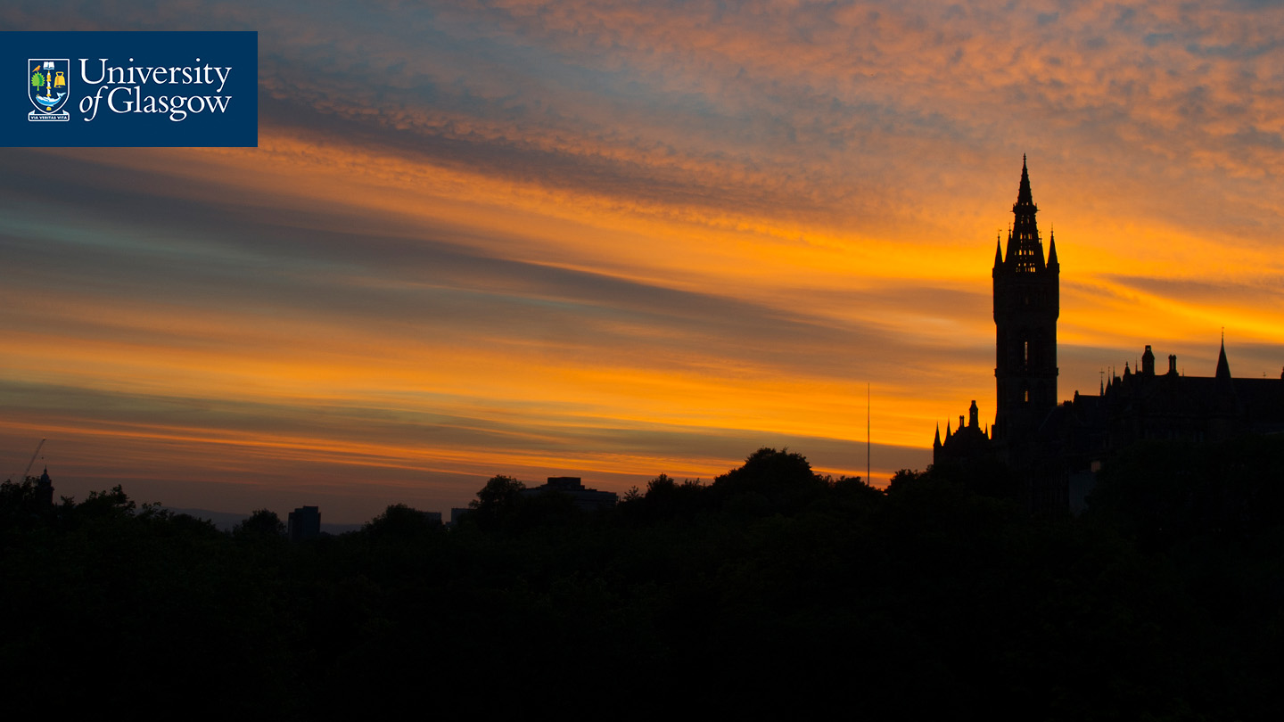


Thank you- see you next week!
#UofGWorldChangers
@UofGlasgow

